Slide 1
Image Signal Processor (ISP)
Abdul Moiz Sheikh

Slide 2
Contents
Types by architecture
Inline
Offline
Types of Processing
Bayer Domain
RGB Domain
YUV Domain

Slide 3
Types by architecture
Inline Architecture
Sensor Transfers the data directly to the ISP
ISP processors the data
Resulting enhanced image saved in memory
ISP needs to be able to process data as it comes in
Faster as compared to Offline architecture
Offline Architecture
Sensor Transfers the data to the memory
ISP processors the data from memory
Resulting enhanced image saved in memory
ISP does not need to process data as it comes in
Sloweras compared to Inline architecture

Slide 4
Types Of Processing
Bayer Domain Processing
Dead Pixel Correction
Black Level Compensation
White Balance Gain Control
Color Filter Array Interpolation
RGB Domain Processing
Color Correction Matrix
Color Space Conversion
YUV Domain Processing
Edge Enhancement

Slide 5
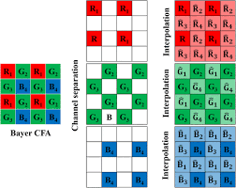
Bayer Domain
Color Images require three basic frames (Red, Green, Blue) to form color images.
Sensors are constrained by bandwidth of raw data transfer
To mitigate this issue sensors transfer data according to Bayer Pattern as shown in figure.
The Missing values for each channel are interpolated.

Slide 6
Bayer Domain Processing
Dead Pixel Correction
Arises due to manufacturing Defects in sensors
Can be also due to Sensing environment
Can be Classified as
Static
Dynamic
Static Defects removed by storing location and correction factor
Dynamic Defects can be corrected by interpolation or gradient based correction.

Slide 7
Bayer Domain Processing
Black Level Correction
Arises due to the fact that voltage for zero level (Black) is not exactly zero, resultantly black pixels are not purely black.
Can be corrected by subtracting a prefixed offset from the individual pixel.

Slide 8
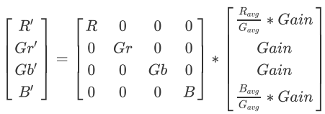
Bayer Domain Processing
White Balance Gain Control
When using Bayer's pattern a overcast of green red or blue is created in parts of image which are supposed to be pure white.
Can be corrected by using following formulae

Slide 9
Bayer Domain Processing
Color Filter Array Interpolation
Used to fill in the empty spaces in each channel by interpolation. This converts the image from Bayer's domain to RGB domain.
Can be implemented using a convolution of a 5x5 matrix with image
Different kernels used for each channel, out of 8 possible kernels , can also be used one after the other.

Slide 10
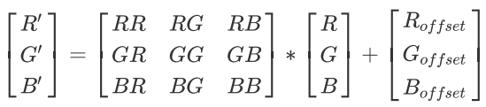
RGB Domain Processing
Color Correction Matrix
Color Images have difficulty in accurately reproducing Color due to lens, filter, light sourcing defects etc.
Can be corrected using color correction matrix.

Slide 11
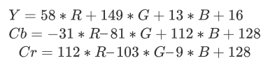
RGB Domain Processing
Color Space Conversion
Used to convert from RGB domain to YCbCr domain.
Can be of one of three types depending on the quality of result image required.
Conversion to BT.2020 standard used to UHDTV is given below

Slide 12
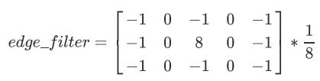
YUV Domain Processing
Edge Enhancement
Used to enhance edges of different objects and sharpen the edges.
Works by increasing the contrast around the edges of the objects.
A sample edge detection matrix in Y channel is shown below.

Slide 13
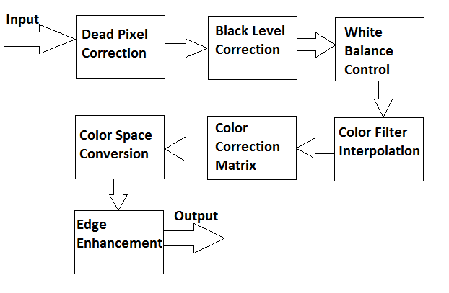
Possible Pipeline for ISP

